Slide 1
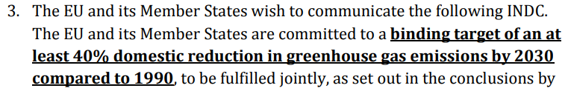
Translating policy targets into modelling scenarios
NDC – European Union
>>AnnualEmissionLimit

Slide 2
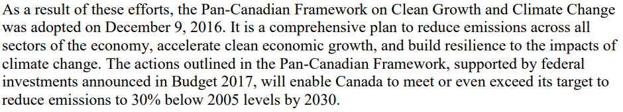
Translating policy targets into modelling scenarios
NDC – Canada
>>AnnualEmissionLimit

Slide 3
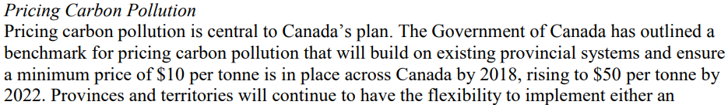
Translating policy targets into modelling scenarios
NDC – Canada
>>EmissionsPenalty

Slide 4
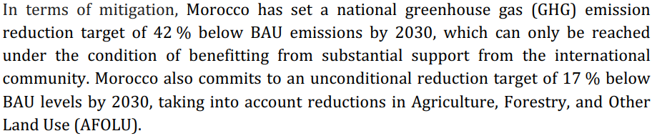
Translating policy targets into modelling scenarios
NDC – Morocco
>>AnnualEmissionLimit

Slide 5
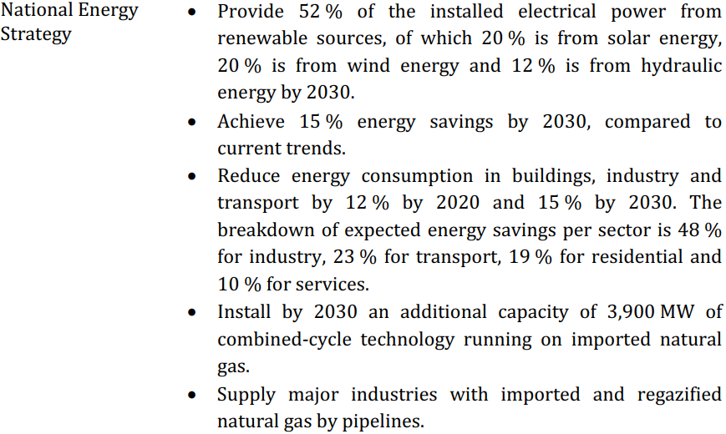
Translating policy targets into modelling scenarios
NDC – Morocco
TotalAnnualMinCapacity<<
SpecifiedAnnualDemand<<
AccumulatedAnnualDemand<<
TotalAnnualMinCapacity<<
TotalAnnualMinCapacityInvestment<<

Slide 6
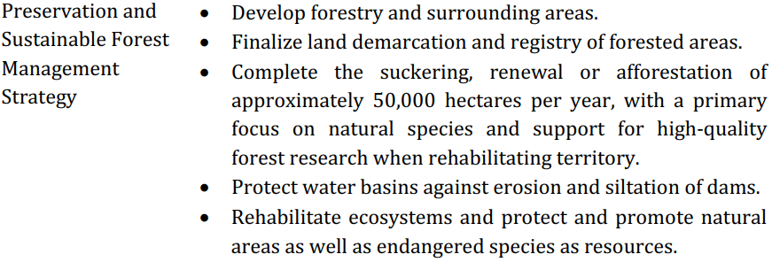
Translating policy targets into modelling scenarios
NDC – Morocco

Slide 7
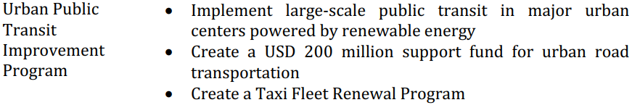
Translating policy targets into modelling scenarios
NDC – Morocco

Slide 8
Defining a scenario in OSeMOSYS
A scenario can be defined in multiple ways:
Enabling/developing entire new energy supply chains (technologies and fuels)
Changing the assumed value of a parameter (e.g. different fuel prices/technology costs)
Blocking/enabling/altering a technology’s installation potential (e.g. commissioning year 2020 to year 2025, maximum installed capacity 2 GW instead of 0.5 GW)
Altering overall system aspects (e.g. assumed CO2 price, required reserve margin etc.)
And many more…

Slide 9
Defining a scenario in OSeMOSYS
Any different input from what has been given in a Baseline Scenario for a specific parameter can result in a different scenario. Key parameters that can assist in defining a new scenario are:
TotalAnnualMaxCapacityInvestment and TotalAnnualMinCapacityInvestment can indicate the maximum and minimum level of capacity installations (i.e. in GW) that can occur in the system in a given year for the respective technology.
TotalAnnualMaxCapacity and TotalAnnualMinCapacity can indicate the maximum and minimum level of total capacity installations (i.e. in GW) that can occur in the system in a given year for the respective technology.

Slide 10
Defining a scenario in OSeMOSYS
AnnualEmissionLimit and EmissionsPenalty impose a limit on the level of emissions of a given pollutant and a penalty (i.e. cost) for each unit of emission of that pollutant.
TotalTechnologyAnnualActivityUpperLimit and TotalTechnologyAnnualActivityLowerLimit can indicate the maximum and minimum level of activity (i.e. production) that can occur in a given year by the respective technology.
TotalTechnologyModelPeriodActivityUpperLimit and TotalTechnologyModelPeriodActivityLowerLimit can indicate the maximum and minimum cumulative level of activity (i.e. production) that can occur by a technology throughout the modelling horizon (e.g. define the level of existing fossil fuel reserves).

Slide 11
Defining a scenario in OSeMOSYS
SpecifiedAnnualDemand can be used to indicate a higher/lower final energy demand than in a Baseline scenario.
CapitalCost can be used to indicate a lower investment cost for specific technologies. E.g. an improved learning rate can result in lower capital costs for solar PV or batteries.
VariableCost can be used to indicate a higher/lower fuel price.

